Slide 1
Unity and Coherence
Hiba Qureshi
Research Scholar
Lecturer
Bahria University Karachi Campus

Slide 2
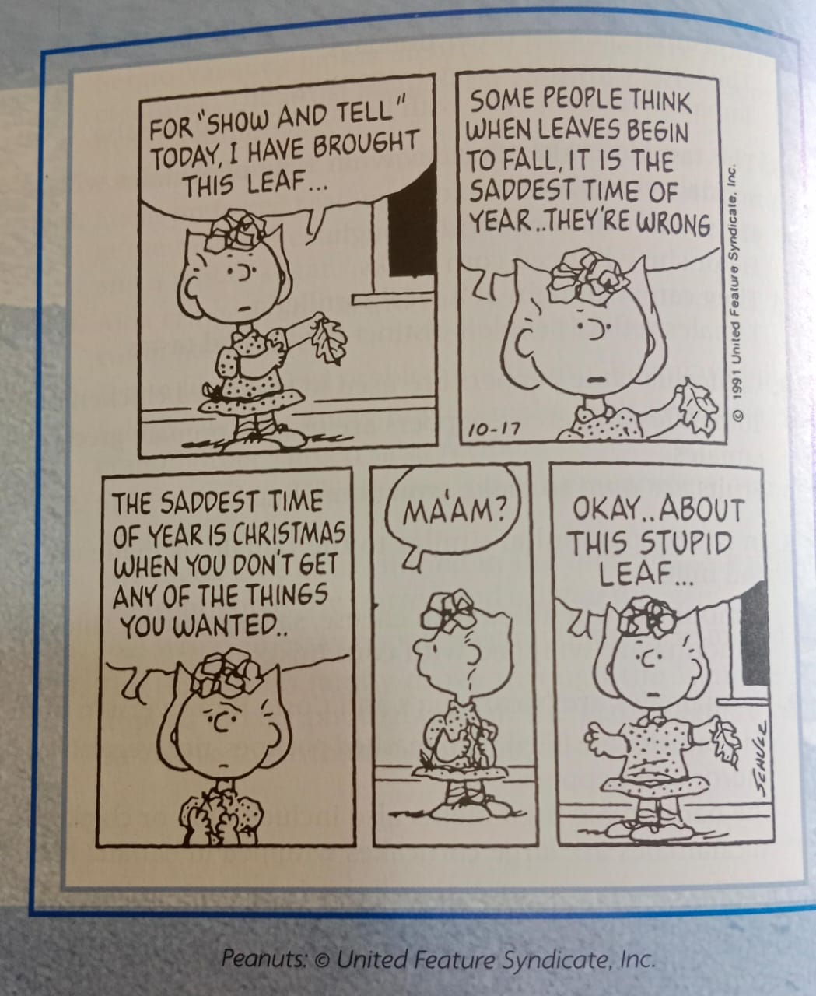

Slide 3
Unity
Drift from the subject/ topic and break in thoughts is called Unity.
It means “Oneness” or “Singleness of Purpose”.
A Unified paragraph or essay.
When is the good time to check UNITY in your writing?

Slide 4
What is unity in writing?
Unity in writing would be when a writer is having all of the details in their work lead to a message.
They convey this message to their reader using a specific structure.
Why is unity important in writing?
Unity is important in writing because it helps the reader understand the message of what is being written about.
It helps by creating cohesion and consistency.

Slide 5
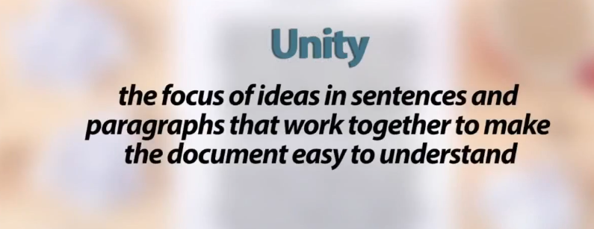
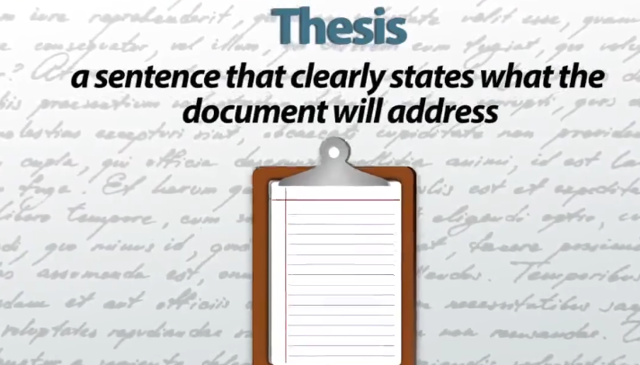

Slide 6
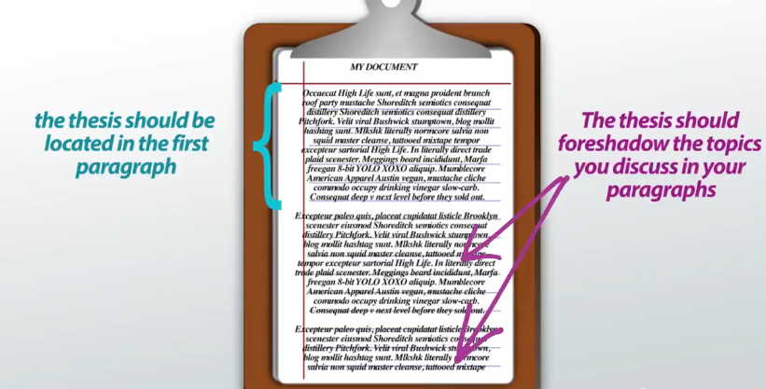

Slide 7
Paragraph Unity
Develop a paragraph around a major idea. Express this idea in the topic sentence.
Make the relationship between the main idea of the paragraph and the thesis sentence.
Don’t assume that the reader will “get it.”
Support the main idea of the paragraph with details.
Create separate paragraphs for those details that explore your topic from different perspectives.
Eliminate sentences that do not support the main idea. Alternately, you may revise the main idea to include those sentences.

Slide 8
“Despite the amount of foreign aid pouring in, social conditions in Zeeland remain bleak because the aid is used for military purposes.”
Robert Bee wrote, “The Zeeland massacre illustrates the need for greater control and vigilance.” This is related to the thesis. Some 20,000 people disappeared from the villages. Financial mishandling can lead to great misfortune. Corruption in the government was exposed repeatedly to no avail. A police force, under orders to eliminate suspected terrorists, grabbed political dissidents and their families.
Is this paragraph UNIFIED?

Slide 9
The pogrom of May 3, 1987 exemplifies how foreign aid funds were appropriated for repressive rather than social development purposes. On that day, some 20,000 people were abducted from villages in the countryside, charged as traitors and summarily executed. Then governor-for-life Zeely Zeelafsun had recently used $5 billion in aid to create a standing paramilitary police force. Without some restrictive control over the aid, human rights organizations were unable to prevent the buildup and unleashing of this disaster. Robert Bee, the director of the Development as Freedom Foundation wrote, “The Zeeland massacre illustrates the need for greater control and vigilance.”
Is this paragraph UNIFIED?

Slide 10
Revise this “poor Unified Paragraph”
Hikers all over Himaliyah can access hiking trails and enjoy nature. Hiking is a good way to get exercise. In southern Himaliyah, hikers enjoy the scenic trails in Zion’s National Park. In northern Himaliyah, trails have been made to showcase the beauties of nature like Waterfall Canyon. Waterfalls all over the world are beautiful. There are hiking paths in Himaliyah’s Rocky Mountains as well that provide beautiful views. But you don’t have to go up to the mountains or drive up the canyon to access hiking trails in Himaliyah. Many cities in Utah have created hiking trails in city parks for people to use that are closer to home. If you like to spend time hiking in nature, there are many hiking trails you can access in Himaliyah.

Slide 11
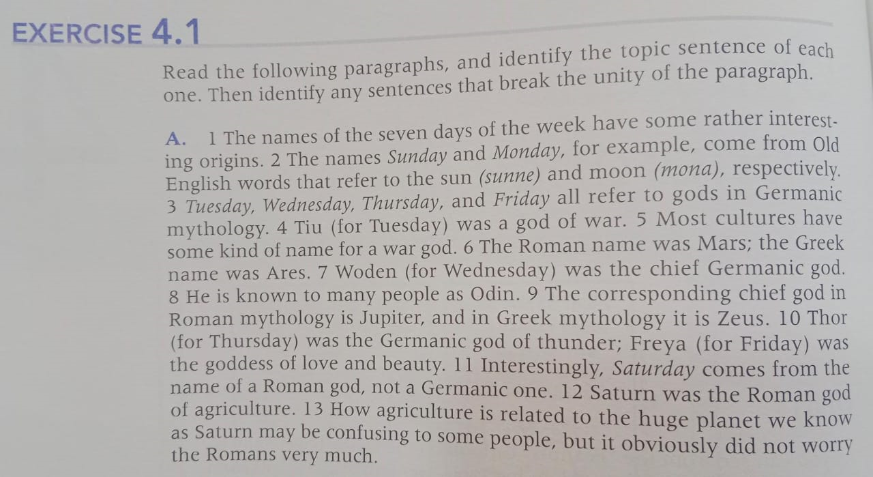

Slide 12
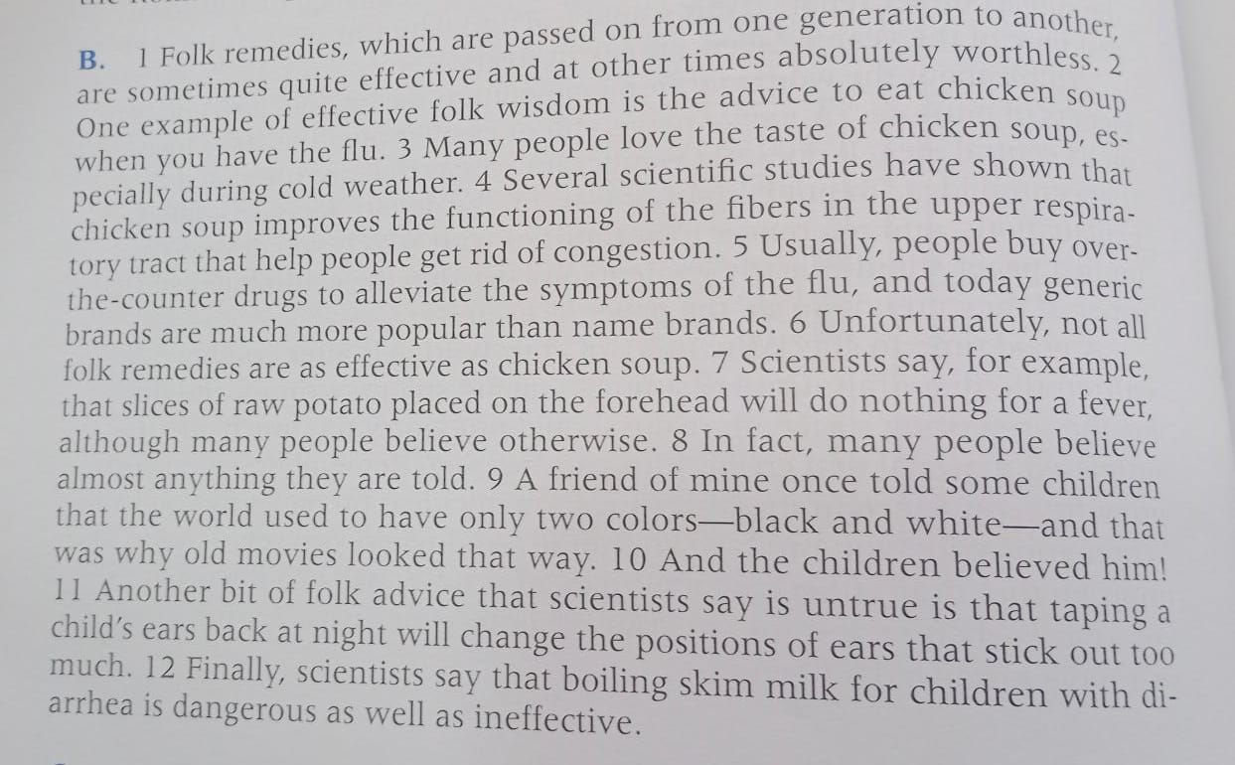

Slide 13
Writing Time....
In order to choose the right diet for you, you need to know what foods you typically eat.

Slide 14
Coherence
It involves clatifying the relationships between ideas.
When ideas/ sentences are coherent, they are understandable.
For instance:
“Snow! Last Winters! Trees! Gone!”
???
What is missing here is....?
(The connection between the ideas)

Slide 15
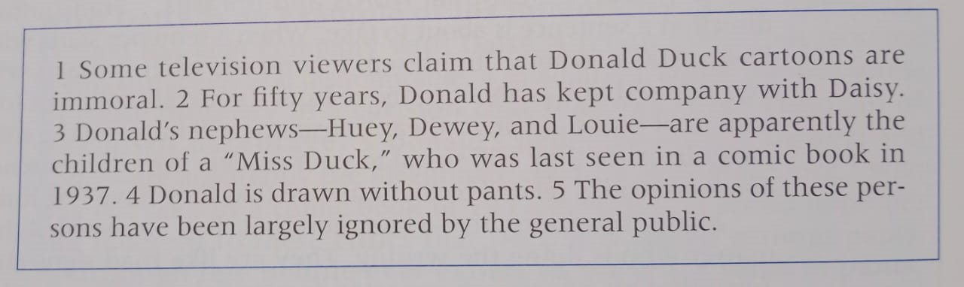

Slide 16
Improving Coherence
Use words that refer to the central idea.
Use common trasitional words ~ which tell you what direction a sentance is about to take.

Slide 17
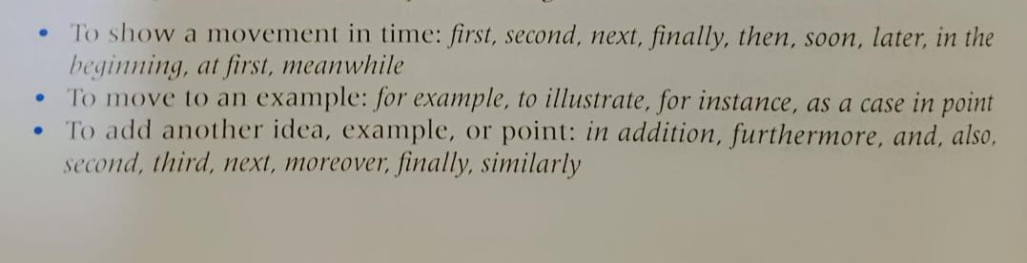
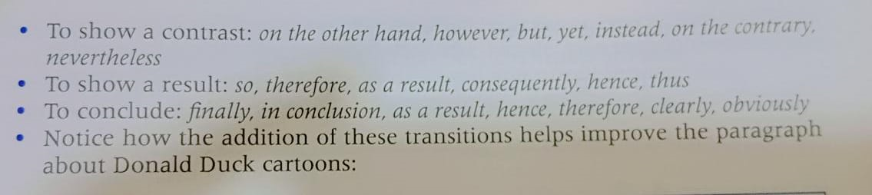

Slide 18
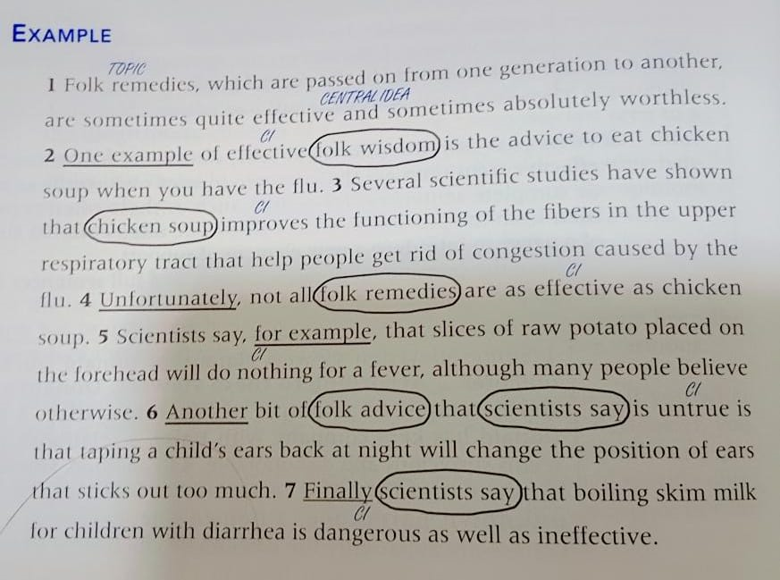
Task

